Slide 1

Over the Bridge Survey Analysis
Kaveesha Jayawardena
Tzu-Chiao Tseng
Bhavna Panwar
Big Data Analytics – BDAT1011

Slide 2

Content
Project Summary
Team Profile
Budget Utilization
Research Questions
Project Milestones
Demo
Recommendations

Slide 3
Project Summary
Over the Bridge (OTB) is a non-profit organization that connects members of the music industry to mental health and addiction recovery education, training, and long-term support services.
Researchers, Paul “Ace” Piva (Over the Bridge), Dr. Nathan Cooper, and Nickie Buchok, developed a study called “Post-Post Performance Mood Responses (PPMR) in Musicians: How Emotional Highs and Lows are Managed Backstage” under the McMaster University ethics guidelines.
Between November 1 and December 13, 2017, OTB used social media to invite musicians from around the world to participate in the study survey. The survey used three sets of survey questions – Demographic, PANAS and Brief Coping Scale questionnaires – to get to the endpoint. The data represents 412 anonymous musicians from across North America to complete the survey study. The study contains roughly 12,000 points of analysis.
The purpose of this project is to analyze the data collected from the afore mentioned survey, to evaluate when musicians have positive or negative mood responses after performances and identify how positive or negative mood responses are managed.

Slide 4
Team Profile (Roles and Responsibilities)
Kaveesha Jayawardena
Tzu-Chiao “Julia” Tseng
Bhavna Panwar
Contributing to overall project objectives
Contributing to overall project objectives
Develop a project plan and manage deliverables according to the plan
Lead and manage the project team
Assign tasks to project team members
Provide regular updates to Stakeholders
Contributing to overall project objectives
Completing individual deliverables
Processing confidential data and information according to guidelines
Completing individual deliverables
Processing confidential data and information according to guidelines
Completing individual deliverables
Develop reports and analysis
Managing and designing the reporting environment, including data sources, security, and metadata
Document technical and business requirements

Slide 5
Budget Utilization
Week | Hours | Standard Rate | Actual Cost | Estimated Cost At Completion | Variance
Week 1 | 15 | $50.00 | $750.00 | $1,000.00 | 250
Week 2 | 9 | $50.00 | $450.00 | $1,000.00 | 550
Week 3 | 11.5 | $50.00 | $575.00 | $1,000.00 | 425
Week 4 | 9 | $50.00 | $450.00 | $1,000.00 | 550
Week 5 | 12.5 | $50.00 | $625.00 | $1,000.00 | 375
Week 6 | 15 | $50.00 | $750.00 | $1,000.00 | 250
Week 7 | 15 | $50.00 | $750.00 | $1,000.00 | 250
Week 8 | 16 | $50.00 | $800.00 | $1,000.00 | 200
Week 9 | 20 | $50.00 | $1,000.00 | $1,000.00 | 0
Week 10 | 17 | $50.00 | $850.00 | $1,000.00 | 150
Week 11 | 21 | $50.00 | $1,050.00 | $1,000.00 | -50
Week 12 | 27 | $50.00 | $1,350.00 | $1,000.00 | -350
Grand Total |  |  | $9,400.00 | $12,000.00 | $2,600.00

Slide 6
Overall Project Expenses

Slide 7
Initial Research Questions
Post-performance Emotions
Segment musicians who experience positive, and/or negative emotions after a performance. What factors contribute to such emotions? (PANAS)
Is there a relationship to the performance (good or bad), social connections, routines of a week, and the frequency of performances? (Demographics & Substance Use + PANAS)
Identify post-performance behavioral patterns amongst and between musicians based on demographics? (Demographics & Substance Use + Brief Coping Scale)
Coping Mechanisms
Classify the spectrum of patterns in how musicians respond, manage, or cope with post-performance mood. (PANAS + Brief Coping Scale)
Identify patterns within the demographics of musicians in how they respond, manage, or cope with their post-performance mood response. (Demographics & Substance Use + Brief Coping Scale)

Slide 8
Project Milestones
Project Kick-Off (Finalizing the Requirements)
Upon receiving the dataset from the client, the team initialized the process of going through the data and getting ourselves familiar with it.
Initially, there were some questions regarding certain data points that we were unfamiliar with, but we were able to resolve those during our project kick-off meeting with Ace.
Data Cleaning Phase 1 - Preparation (January 19th – January 27th, 2020)
Once we were confident that we are familiar with all components of our dataset, and that we understood all our client’s requirements, the team started the Data Cleaning Phase of the project.
Since the dataset had responses from 3 main components namely, Demographics and Substance Use Questionnaire, PANAS Questionnaire, and Brief Coping Scale Questionnaire, we divided the 3 components amongst the team as below,
Demographics and Substance Use Questionnaire – Kaveesha Jayawardena
PANAS Questionnaire – Tzu-Chiao “Julia” Tseng
Brief Coping Scale Questionnaire – Bhavna Panwar
The team then carried out the data cleaning for each component assigned to them.

Slide 9
Project Milestones (contd.)
Data Cleaning Phase was carried out in 4 workflow items,
Inspection – Detect unexpected, incorrect, and inconsistent data
Cleaning – Fix or remove the anomalies discovered
Verifying – After cleaning, the results are inspected to verify correctness
Reporting – Report the changes made and the quality of the currently stored data is recorded
Findings
 | Total # of Questions | Total # of Cells | Total # of Cells with Data | Total % of Cells with Data | Total # of Empty Cells | Total % of Empty Cells
Demographics & Substance Use Questionnaire | 27 | 265598 | 149048 | 56% | 116550 | 44%
PANAS Questionnaire | 20 | 70602 | 10849 | 15% | 59753 | 85%
Brief Coping Scale Questionnaire | 28 | 97382 | 9395 | 10% | 87987 | 90%
Total # of Questions | 75

Slide 10
Project Milestones (contd.)
Findings (contd.)
Challenges
MS Excel keeps crashing when trying to replace empty cells with “Null”, and when trying to remove multiple empty rows at once.
Solutions
Divided the dataset into the same 3 sections as previously divided between the team (Demographics and Substance Use Questionnaire, PANAS Questionnaire, and Brief Coping Scale Questionnaire), replaced the values, removed the empty rows, and then consolidated everything into one worksheet.
Total # of Rows | 3362
Empty Data (Null or N/A) | 2882
Total # of Rows Containing Data | 480
Agree to Participate | 477
Did not complete the survey | 65
Actual Results to Analyse | 412

Slide 11
Project Milestones (contd.)
Data Cleaning Phase 2 – Consolidating and Reporting (January 28th – February 05th, 2020)
During this phase, we consolidated all the cleaned data into one main dataset. And also, we documented all the changes made to the dataset for future reference.
Findings
During the cleaning process, we found out that there are certain cells that contained qualitative data. Since we were planning to run analysis such as summary statistics and correlation, we decided to transform the said qualitative data into quantitative data (numerical).
Challenges
We found out that during Data Cleaning Phase 1, some values in certain variables had their data type changed, along with their original values.
Solutions
Revisited the original dataset to see which values had been changed, and replaced those with the correct values in the dataset.

Slide 12
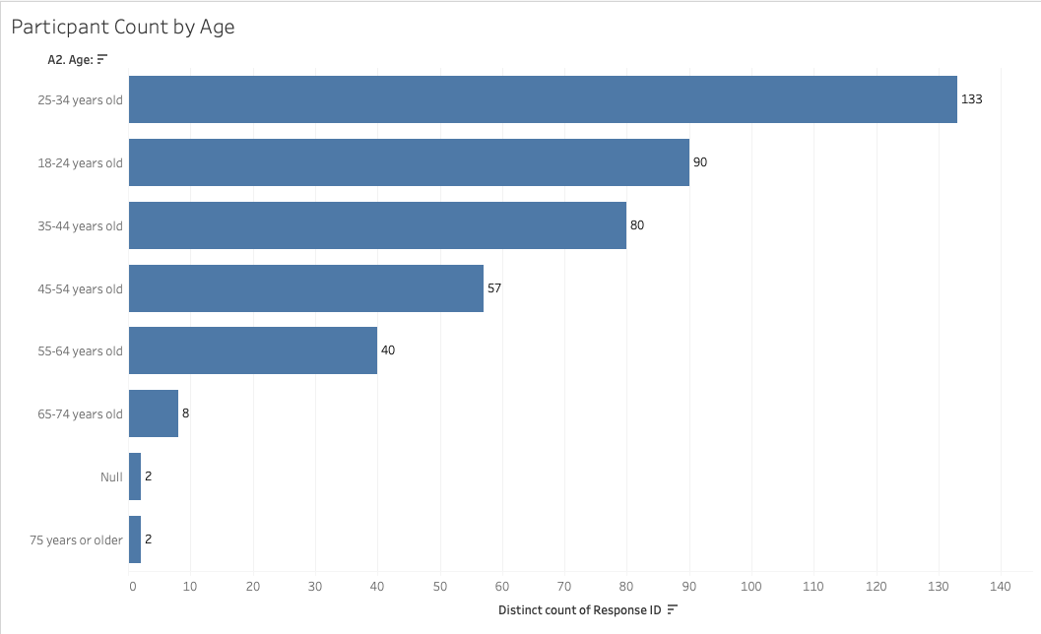
Project Milestones (contd.)
Designing the Primary Level Visualizations (February 06th – February 14th, 2020)
Once we were done with data cleaning, as well as transforming the data, we did some primary level visualizations on our data using Tableau software.
Visualization Samples

Slide 13
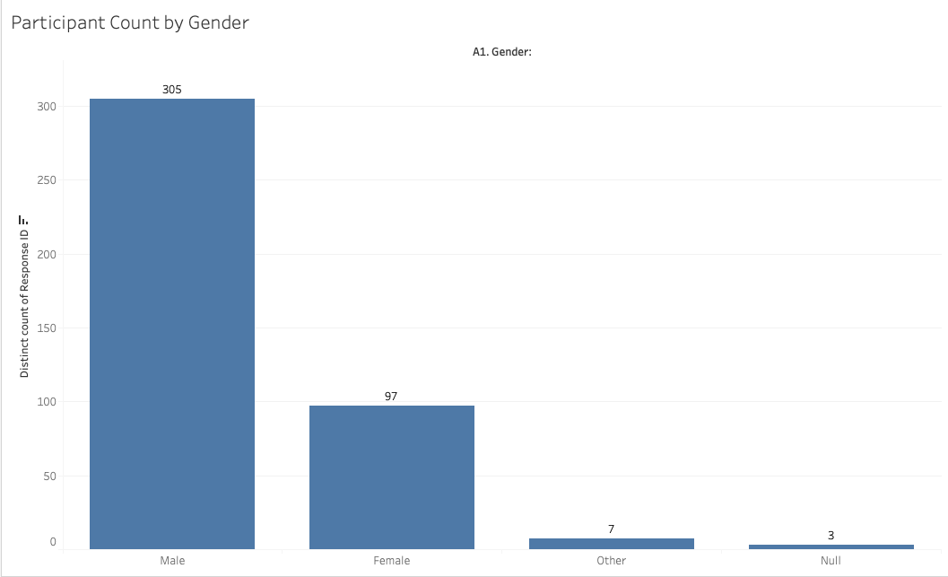
Project Milestones (contd.)
Visualization Samples (contd.)

Slide 14
Project Milestones (contd.)
Data Analysis Phase (February 15th – March 28th)
The first part of this phase mainly focused on a methodology to bin the data in 13 variables that have free-form comments to support our analysis,
For questions that ask the survey participants to elaborate on an answer given previously (eg: “if other please specify”), we will be looking into gathering keywords from the responses to create WordClouds to visualize key factors contributing to certain behavioural patterns, mood responses, etc.
For independent free-form comments, we will be looking into extracting Yes/No answers using Python’s support libraries.
To achieve this, we tested Python’s NLTK package to extract the keywords. We created a program and tested it for one of the variables and was able to successfully extract the keywords from the comments.
We then tested Azure Cognitive Services to do the same task
Afterwards we compared the results of the two algorithms and concluded that Azure Cognitive Services – Text Analytics is the most accurate out of the two.

Slide 15
Project Milestones (contd.)
Challenges
Initially we did not have a proper methodology to analyse the variables with free-form comments.
Solutions
Talked to Prof. Eli Kane about the issue we were facing, and he suggested that we research on keyword extraction methodologies using programming languages.
Our research proved that Python has some libraries that support this, and so we decided to perform a feasibility test on each library to find out which one gives the most accurate results.

Slide 16
Project Milestones (contd.)
Data Visualization Phase (February 15th – March 28th)
This phase was done in parallel to the analysis of data.
We decided to create separate dashboards for each research question, since it will be too much information to be put into one.
Visualization was carried out using Tableau software.
We were able to create multiple interactive dashboards that showcased all our findings related to the research questions.
The end user’s have the ability to filter out data, and also make changes to the dashboards as they wish, since the Excel sheets used for analysis are already loaded to Tableau.

Slide 17
Demo

Slide 18

Research Question 1
Segment musicians who experience positive, and/or negative emotions after a performance. What factors contribute to such emotions?
Related Survey Component – PANAS
Presented By: Tzu-Chiao “Julia” Tseng

Slide 24
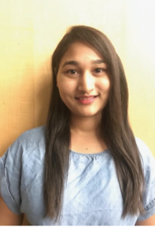
Research Question 2
Is there a relationship to the performance (good or bad), social connections, routines of a week, and the frequency of performances?
Related Survey Component – Demographics & Substance Use + PANAS
Presented By: Bhavna Pnawar

Slide 26

Research Question 3
Identify post-performance behavioral patterns amongst and between musicians based on demographics?
Related Survey Component – Demographics & Substance Use + Brief Coping Scale
Presented By: Kaveesha Jayawardena

Slide 30
Research Question 4
Classify the spectrum of patterns in how musicians respond, manage, or cope with post-performance mood.
Related Survey Component – PANAS + Brief Coping Scale
Presented By: Tzu-Chiao “Julia” Tseng

Slide 33
Recommendations
Current Recommendations
At the initial meeting with our Client, we suggested the below deliverables to him,
A detailed written report which includes:
A full description of the approach to the data collection and its preparation for analysis
Documentation for each Analysis
Visualization of the Analysis Results
High-level observations and conclusions
The Analysis Models and Codes for the Analysis
Knowledge transfer of all the analysis, technology and documentation
We also suggested that instead of using Excel for visualizations, we can use a software such as Tableau. This helps to create different dashboards, as well it increases the presentation quality.
Recommendations for the Next Phase
As we were going through the dataset we came up with some suggestions regarding the design of the survey,
Reduce the number of questions (maybe split the survey into different sections)
Reduce the number of questions that expect free-form comments since they pose challenges to the analysis process

Slide 34
Project Deliverables
A PowerPoint Presentation which includes:
A full description of the approach to the data collection and its preparation for analysis
Documentation for each Analysis
Visualization of the Analysis Results
High-level observations and conclusions
The Analysis Models and Codes for the Analysis
Knowledge transfer of all the analysis, technology and documentation

Slide 35
Q & A Session

Slide 36
THANK YOU!

